Slide 1


Task 2
Internship Studio’s Ethical Hacking Internship
Name : Yogesh Nema
E-mail: yogeshnema16@gmail.com Contact no.: 8982398320

Slide 2
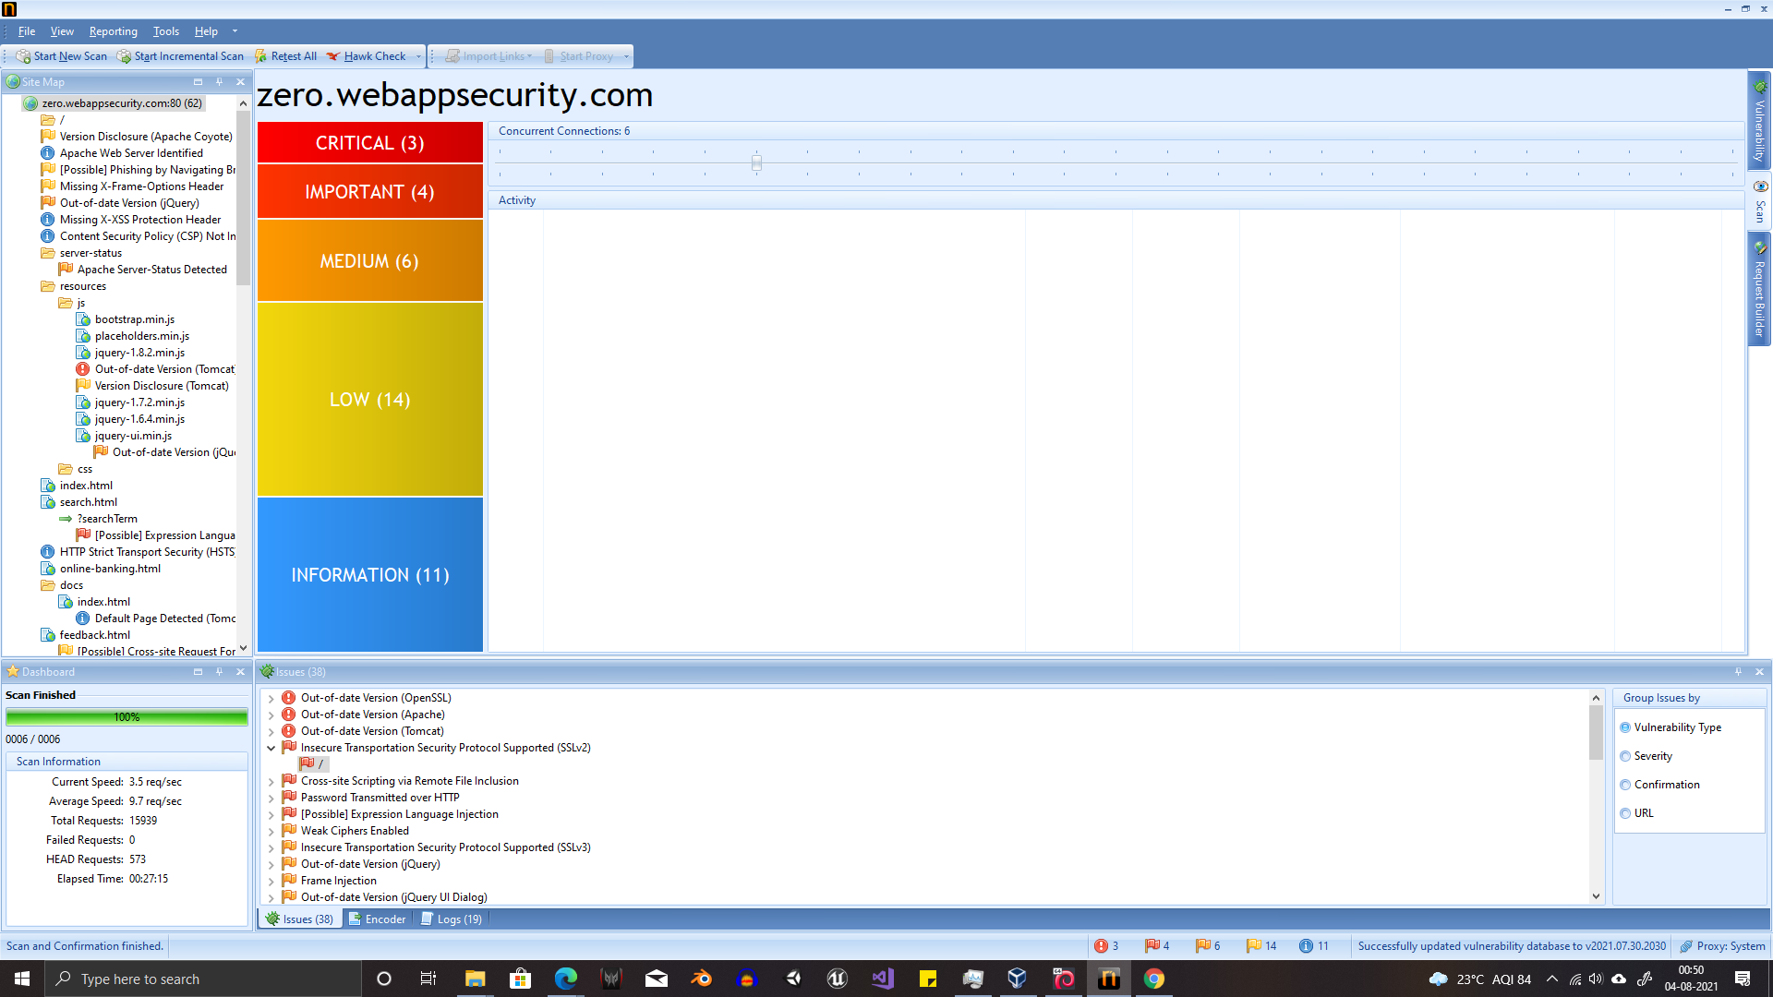

Slide 3
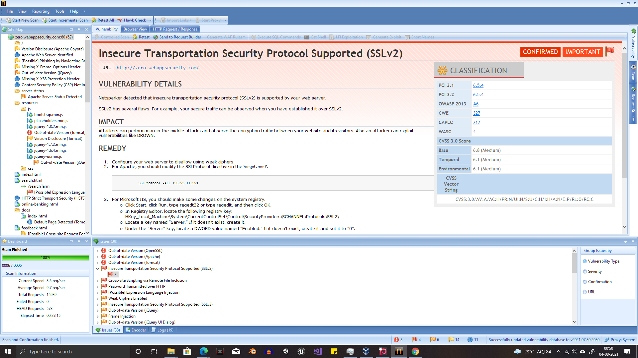

Slide 4
REPORT
Cross-Site Scripting Vulnerability Found
Site Name: Zero Bank’s Website
URL : http://zero.webappsecurity.com/
Details : In the above mentioned site Cross-site Scripting via Remote File Inclusion was found possible, which cannot be ignored as this vulnerability allows a person to make changes to the site using dynamic scripts.
This creates opportunity for many different types of attack few of the possible attacks are a user can change the site’s appearance with help of dynamic scripts, they can create unwanted pop-ups or alerts making site less user friendly, it can leak out cookies from browsers
Impact: An attacker may:
Steal session details
Change website’s appearance
Intercept data flowing from user to the server
Solution:
Filter input on arrival. At the point where user input is received, filter as strictly as possible based on what is expected or valid input.
Encode data on output. At the point where user-controllable data is output in HTTP responses, encode the output to prevent it from being interpreted as active content. Depending on the output context, this might require applying combinations of HTML, URL, JavaScript, and CSS encoding

Slide 5
Thank You

